Slide 1
Image-Based Situation Awareness Audit 8.5.2018
Sakari Lampola

Slide 2
Previous Audit 28.2.2018

Slide 3
Next steps
Kalman filter parameter adjustments (Q1)
Dataset selection (Q1)
Stereo vision (Q2)
Camera yaw, pitch, roll estimation (Q2)
Speech recognition (Q2)
Semantic segmentation (Q2)
Experiments in the wild (Q2)
Paper (Q3)
Speech analysis (Q3)
Speech generation (Q3)
Use cases (Q4)
Other
Body forecast
kinetic
based on class history
based on swarm history
R matrix estimation
Monograph or papers

Slide 4
Project Plan

Slide 5

Methodology / Preparation of research infra
Software platforms are constructed and tested
Off-the-shelf models are acquired and tested
Necessary skills on platforms are learned
Methodology / Method survey
Current state-of-art methods are studied
Methods are constructed and tested on the software platforms
Method follow-up
Screening of conference papers related to the subject
Possibly integrating new methods to the project

Slide 6
Work Done

Slide 7
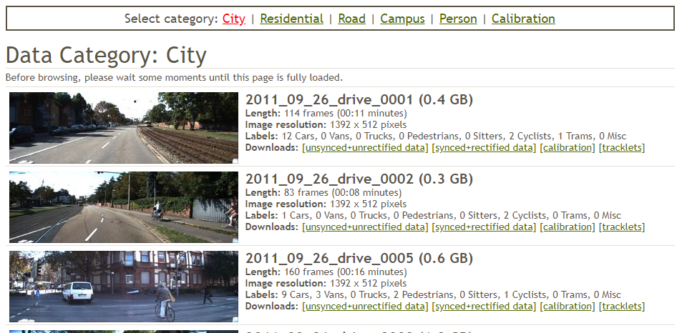
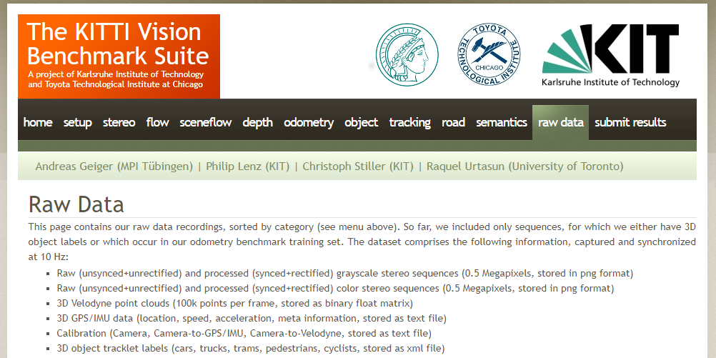
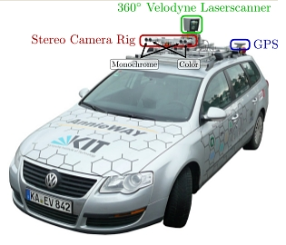
Specification:
Video
Stereo
Distance information
Outdoor + indoor
Odometry
Dataset Selection
Open question: Indoor? Self generated?

Slide 8
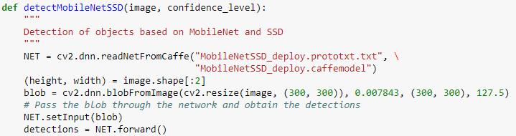
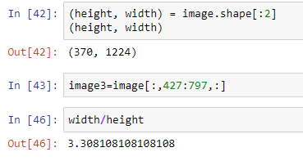
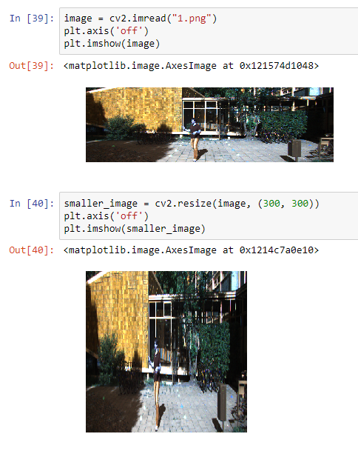
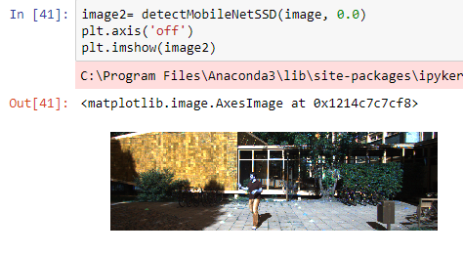
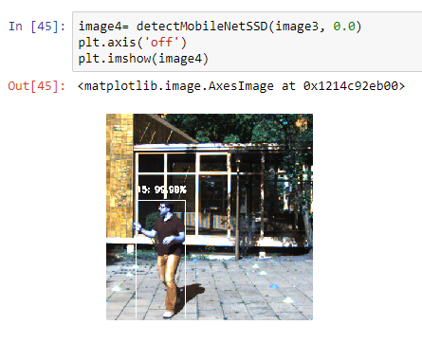
Image is resized to 300*300 pixels

Slide 9
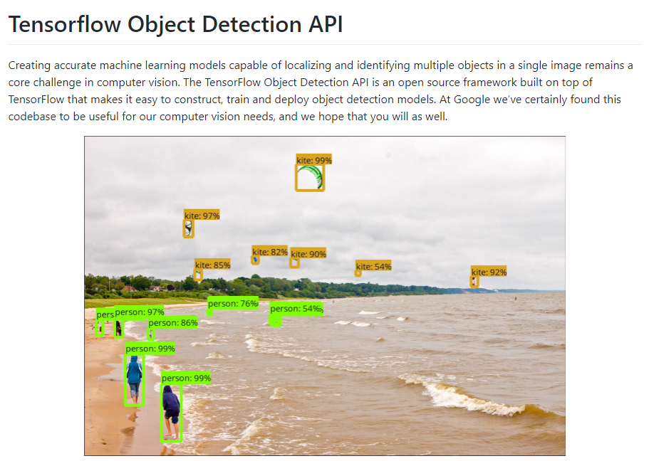
Resized KITTI image is too deformed to be useful. We need another network implementation!
https://github.com/tensorflow/models/tree/master/research/object_detection

Slide 10
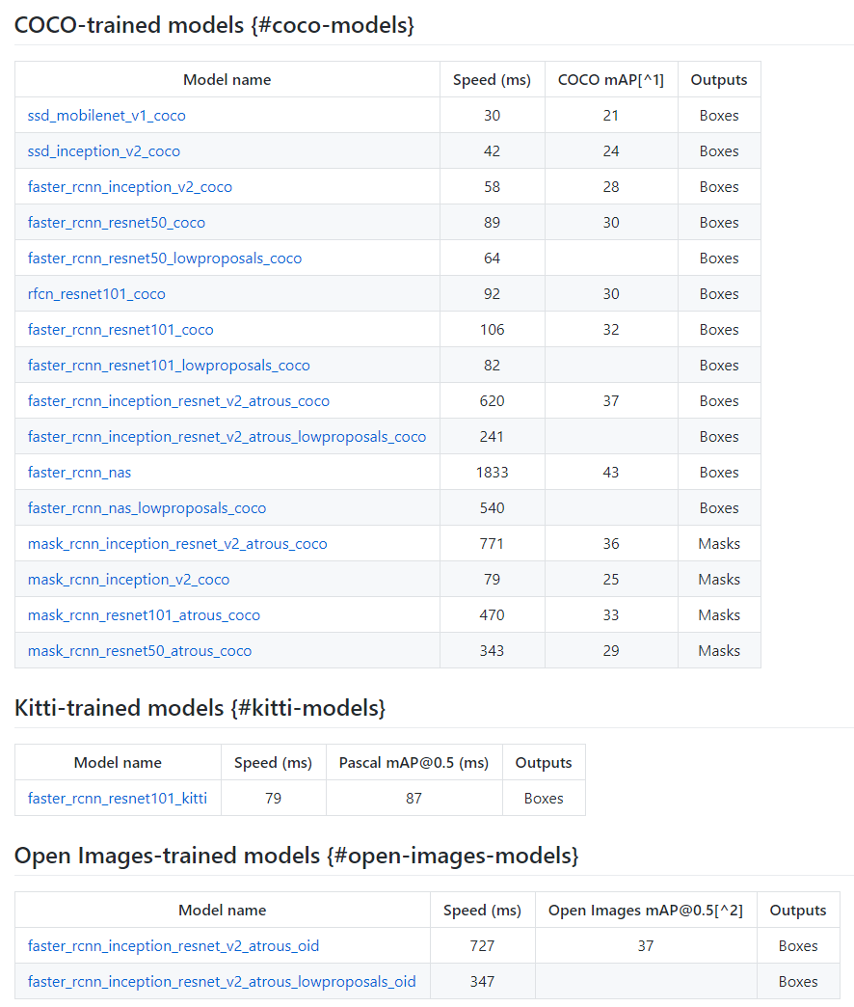
One of these will be the final model.
Lottery prize!!!! Will be used to implement localization and velocity estimation

Slide 11

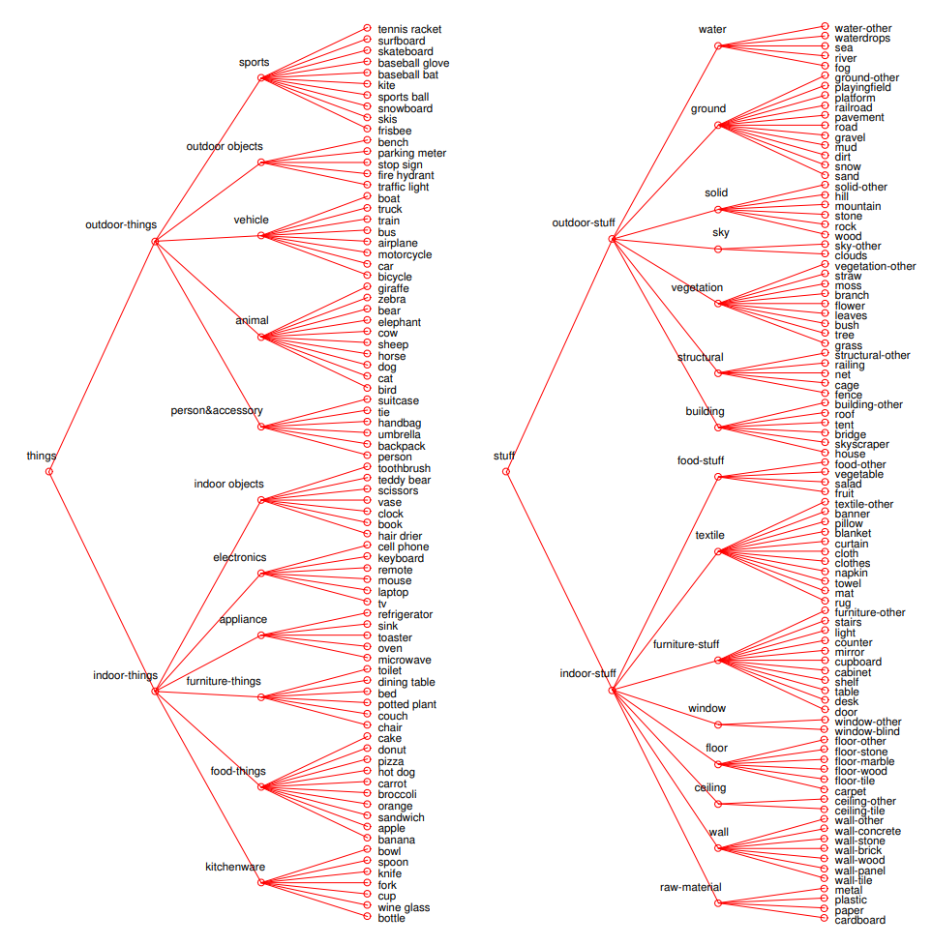

Slide 12
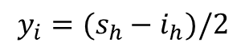
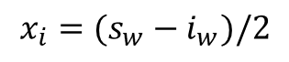
Image format / cropping
s_{w} = sensor pixel width = 1392
x_{i},y_{i}
i_{w} = image pixel width
s_{h} = sensor pixel height = 512
i_{h} = image pixel height
Assumptions:
image is symmetrically cropped (optical center fixed)
rectification ignored
$$x_{i}=(s_{w}−i_{w})/2$$
$$y_{i}=(s_{h}−i_{h})/2$$

Slide 13
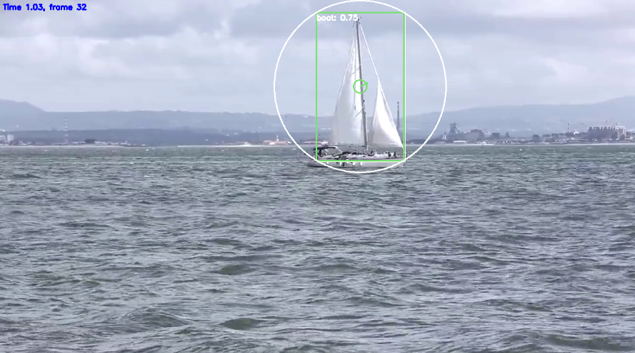
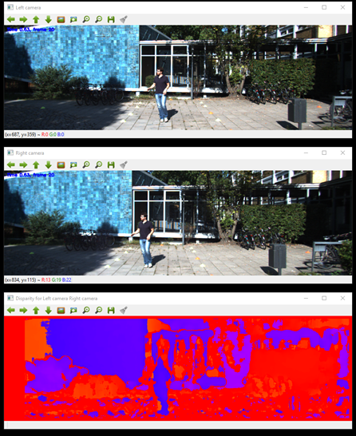
Left
Right
Stereo Vision
disparity d

Slide 14
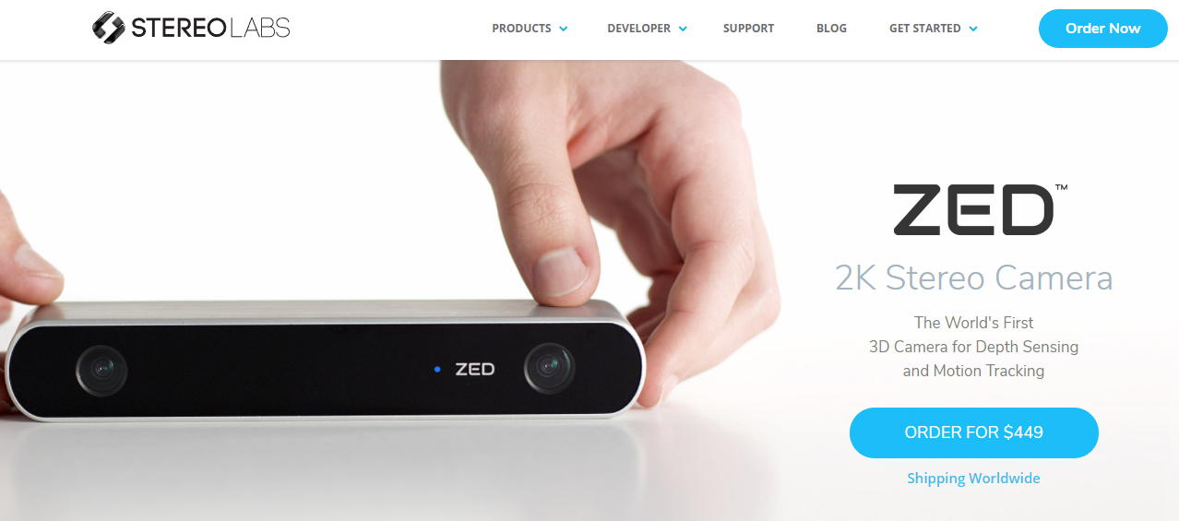
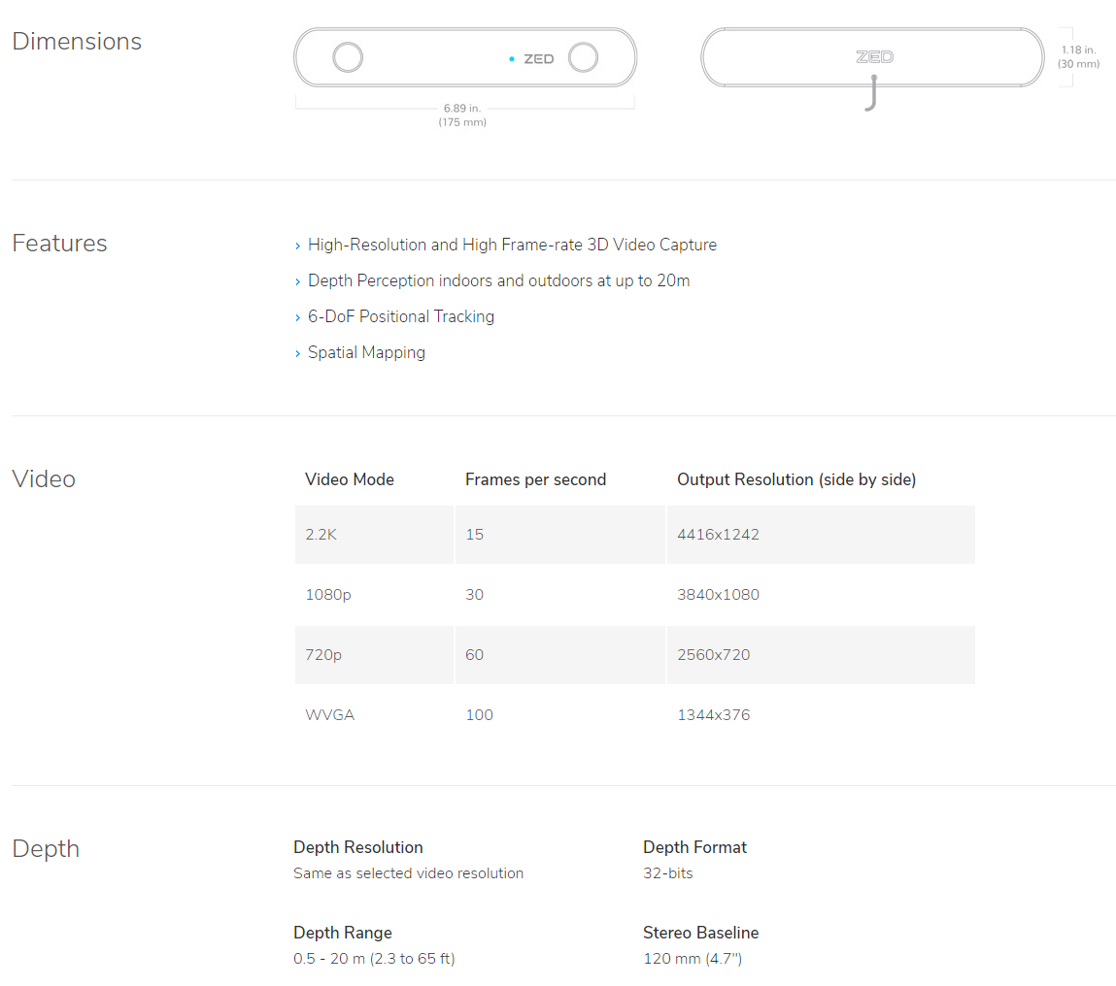
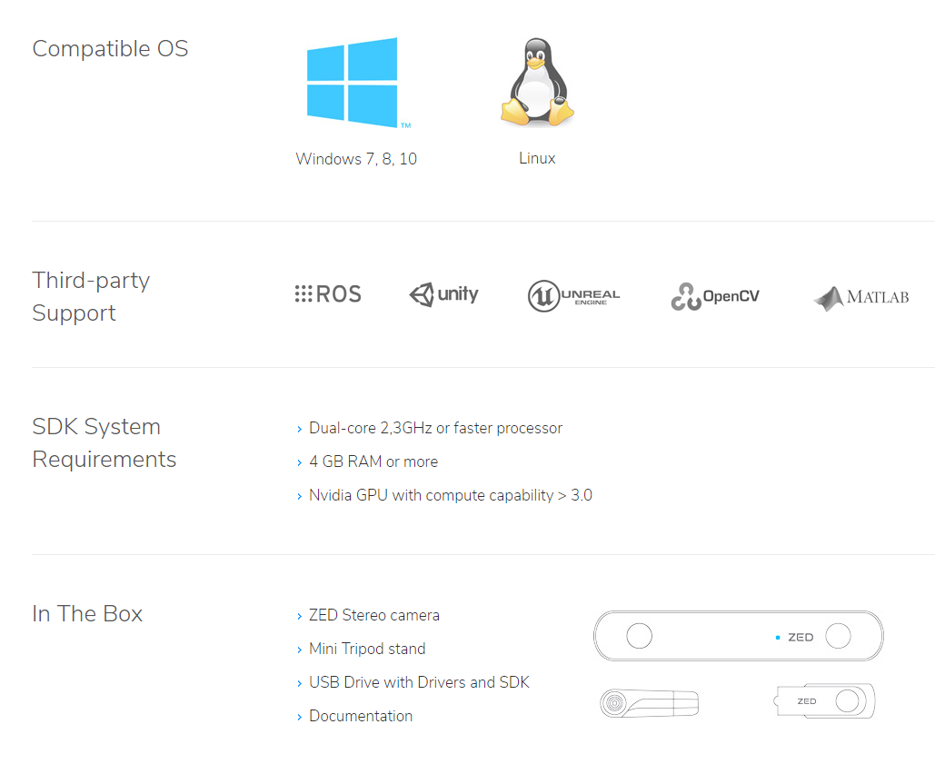

Slide 15
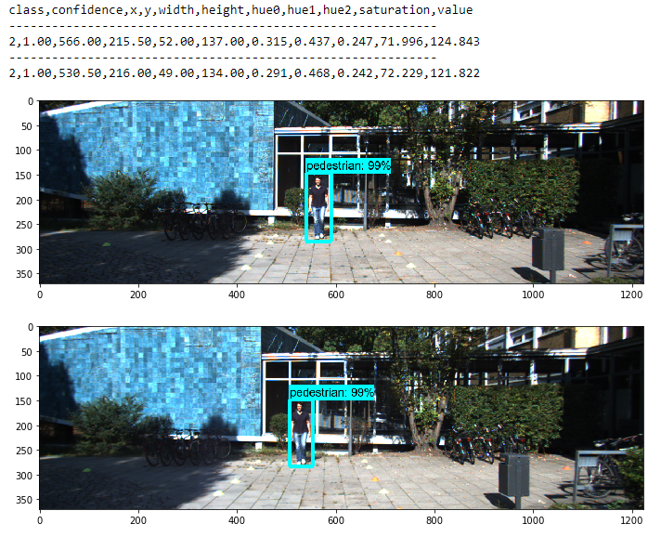
Mapping left and right image patterns
Pattern features to match
x,y = bounding box center location
saturation,value = mean values
3-bin hue histogram:
hue0
hue1
hue2

Slide 16
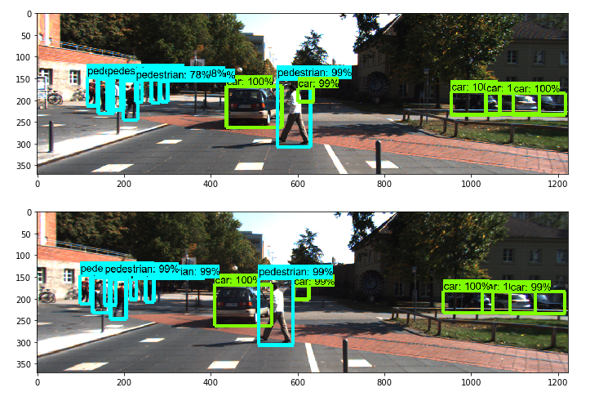
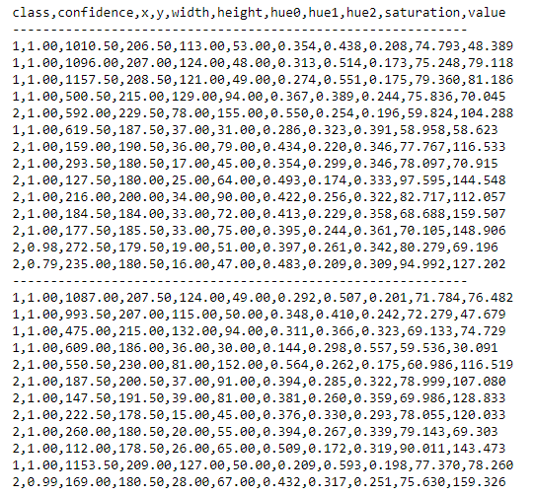
Pattern matching based on feature difference is required!

Slide 17
Probabilistic model answering the question: What is the probability two patterns represent the same object?
Feature vector F:
confidence
x
y
width
heigth
hue0
hue1
hue2
saruration
value
Assumption:
P(i and j are same pattern) ~ N(F_{i} – F_{j} ∣ μ_{F} , V_{F})
Note: Class is not included as it is required to be the same

Slide 18
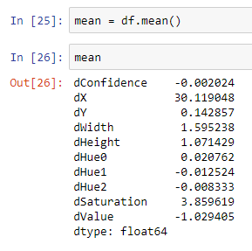
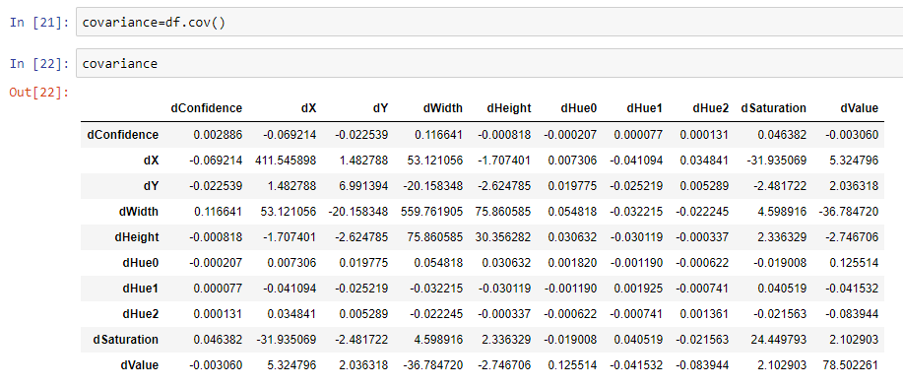
μ_{F} , V_{F} were estimated by matching 84 patterns in 28 KITTI stereo image pairs representing city, residential, campus and
person categories, including both cars and pedestrians.
Note: Mean disparity (dX) is appr. 30 pixels

Slide 19
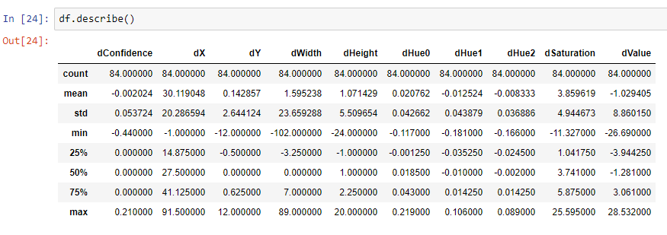

Slide 20
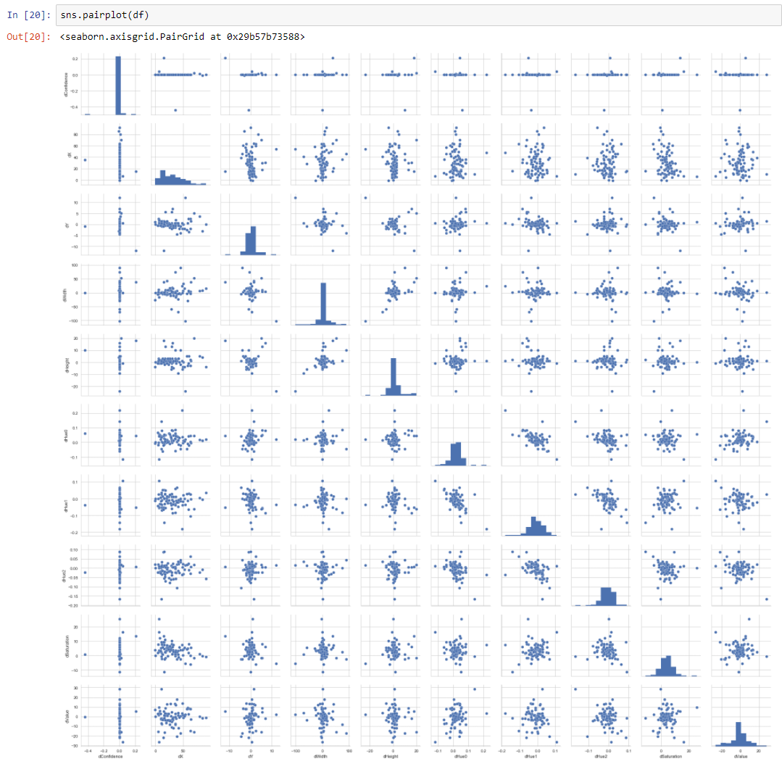

Slide 21
Pattern matching is done using Hungarian algorithm with the distance metrics:
d_{ij} = -log(P(i and j are same pattern)) = -log(N(F_{i} – F_{j} ∣ μ_{F} , V_{F}) )
If the probability that the patterns are same is near 1, the distance will be near zero. As the probability
decreases, the distance increases. The log is required to compare small numbers without numerical issues.

Slide 22
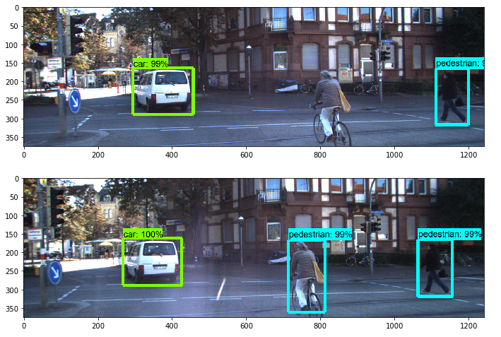
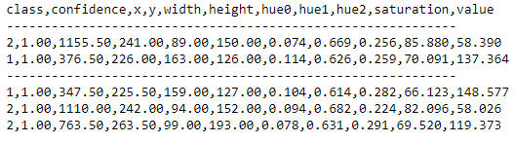
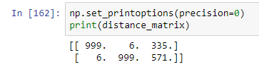
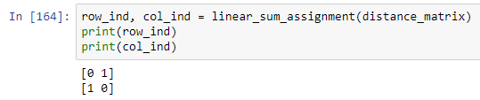
Simple example

Slide 23
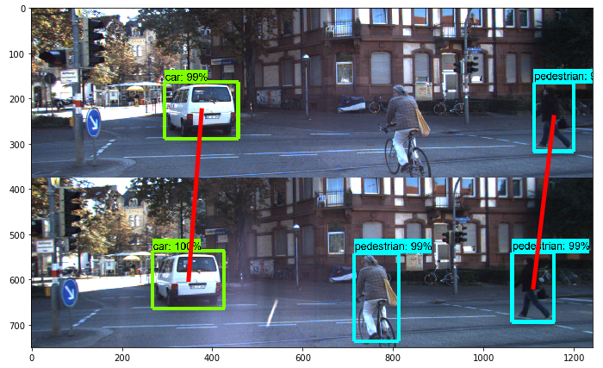

Slide 24
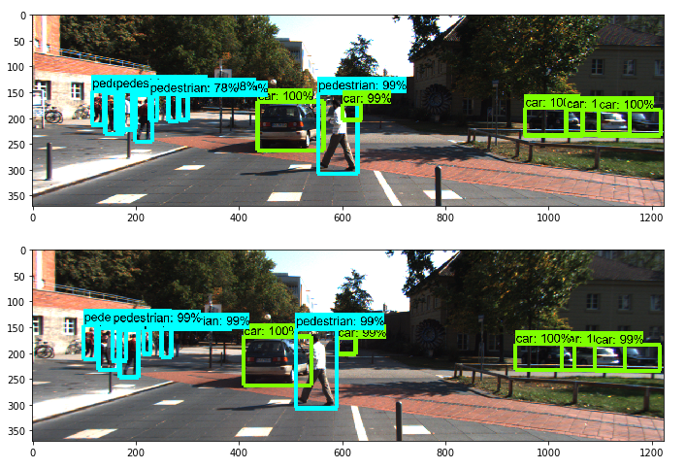
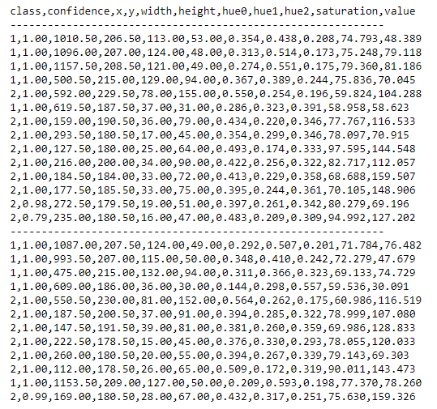
Complicated example

Slide 25
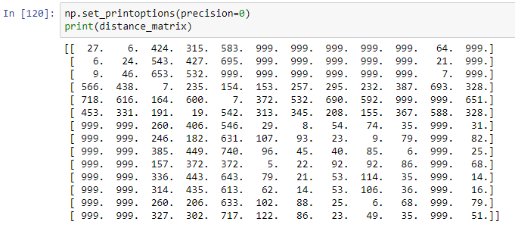
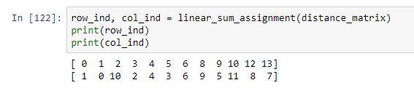

Slide 26
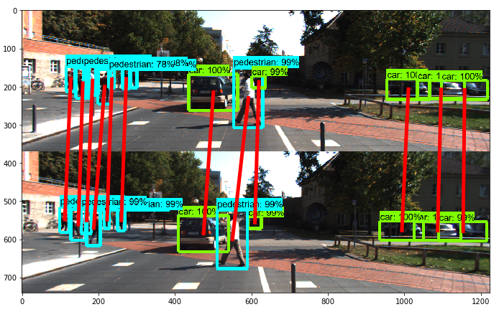

Slide 27
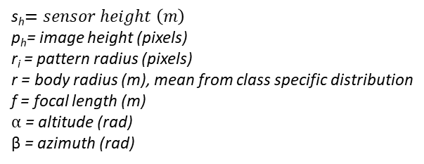
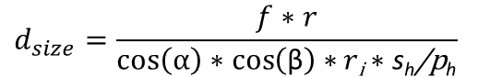
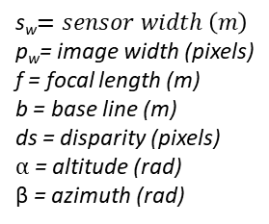
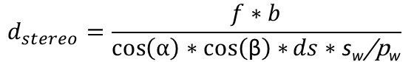
After implementing stereo vision, we have two distance estimates:
Distance based on stereo vision. Accurate in short distances (for Kitti, 20 meters)
Distance based on size. Can be used in long distances where stereo vision is inaccurate.
D
F
h
d =AF
C
E
G
h_{i}
α
A
B
f
$$d_{size}=\frac{f∗r}{\cos\left(α\right)∗\cos\left(\text{β}\right)∗r\text{i}∗\text{s}\text{h}\text{/}\text{p}\text{h}}$$
$$d_{stereo}=\frac{f∗b}{\cos\left(α\right)∗\cos\left(\text{β}\right)∗ds∗\text{s}\text{w}\text{/}\text{p}\text{w}}$$
s_{h}$=sensor height \left(m\right)$
p_{h}= image height (pixels)
r_{i} = pattern radius (pixels)
r = body radius (m), mean from class specific distribution
f = focal length (m)
$α$ = altitude (rad)
β = azimuth (rad)
s_{w}$=sensor width \left(m\right)$
p_{w}= image width (pixels)
f = focal length (m)
b = base line (m)
ds = disparity (pixels)
$α$ = altitude (rad)
β = azimuth (rad)

Slide 28
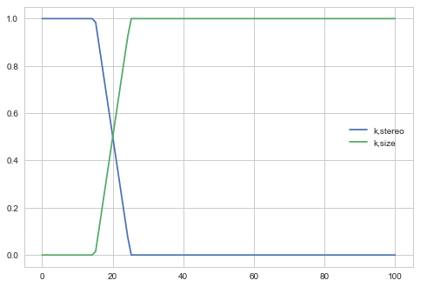
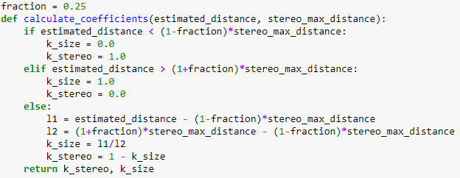
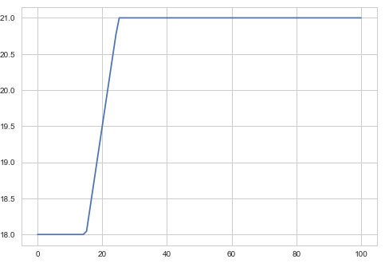
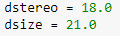
Combining distance estimates:
$d=k_{stereo}∗d_{stereo}+$ $k_{size}∗d_{size}$
stereo_max_distance = 20.0
Initialization:
$estimated_distance=0.5∗d_{stereo}+$ $0.5∗d_{size}$
Procedure is iterated until convergence or max_iter (or just used once?)

Slide 29
Estimating disparity using matched patterns
Left camera pattern:
x_min_left
x_max_left
Right camera pattern:
x_min_right
x_max_right
$Pattern disparity=$ 0.5 * (x_min_left+x_max_left)-0.5*(x_min_right+x_max_right)

Slide 30
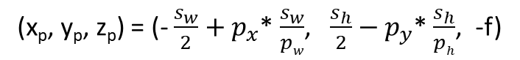
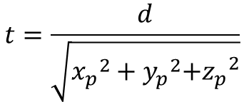
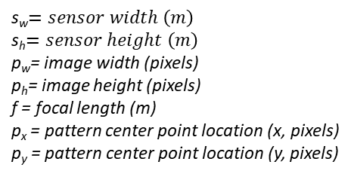
3D projection
x_{b},y_{b},z_{b} = body center point
y
x_{p},y_{p},z_{p} = pattern center point
x
z
(x_{b}, y_{b}, z_{b}) = t* (x_{p}, y_{p}, z_{p})
s_{w}$=sensor width \left(m\right)$
s_{h}$=sensor height \left(m\right)$
p_{w}= image width (pixels)
p_{h}= image height (pixels)
f = focal length (m)
p_{x} = pattern center point location (x, pixels)
p_{y} = pattern center point location (y, pixels)
Where:
(x_{p}, y_{p}, z_{p}) = (- $\frac{s_{w}}{2}+p_{x}$* $\frac{s_{w}}{pw}$, $\frac{s_{h}}{2}−p_{y}$* $\frac{s_{h}}{ph}$, -f)
$$t=\frac{d}{\sqrt{{x_{p}}^{2}+{y_{p}}^{2}{{+z}_{p}}^{2}}}$$
Note! Only left image used. Right image is used only for disparity calculation (in the context of distance estimation and 3D projection).

Slide 31
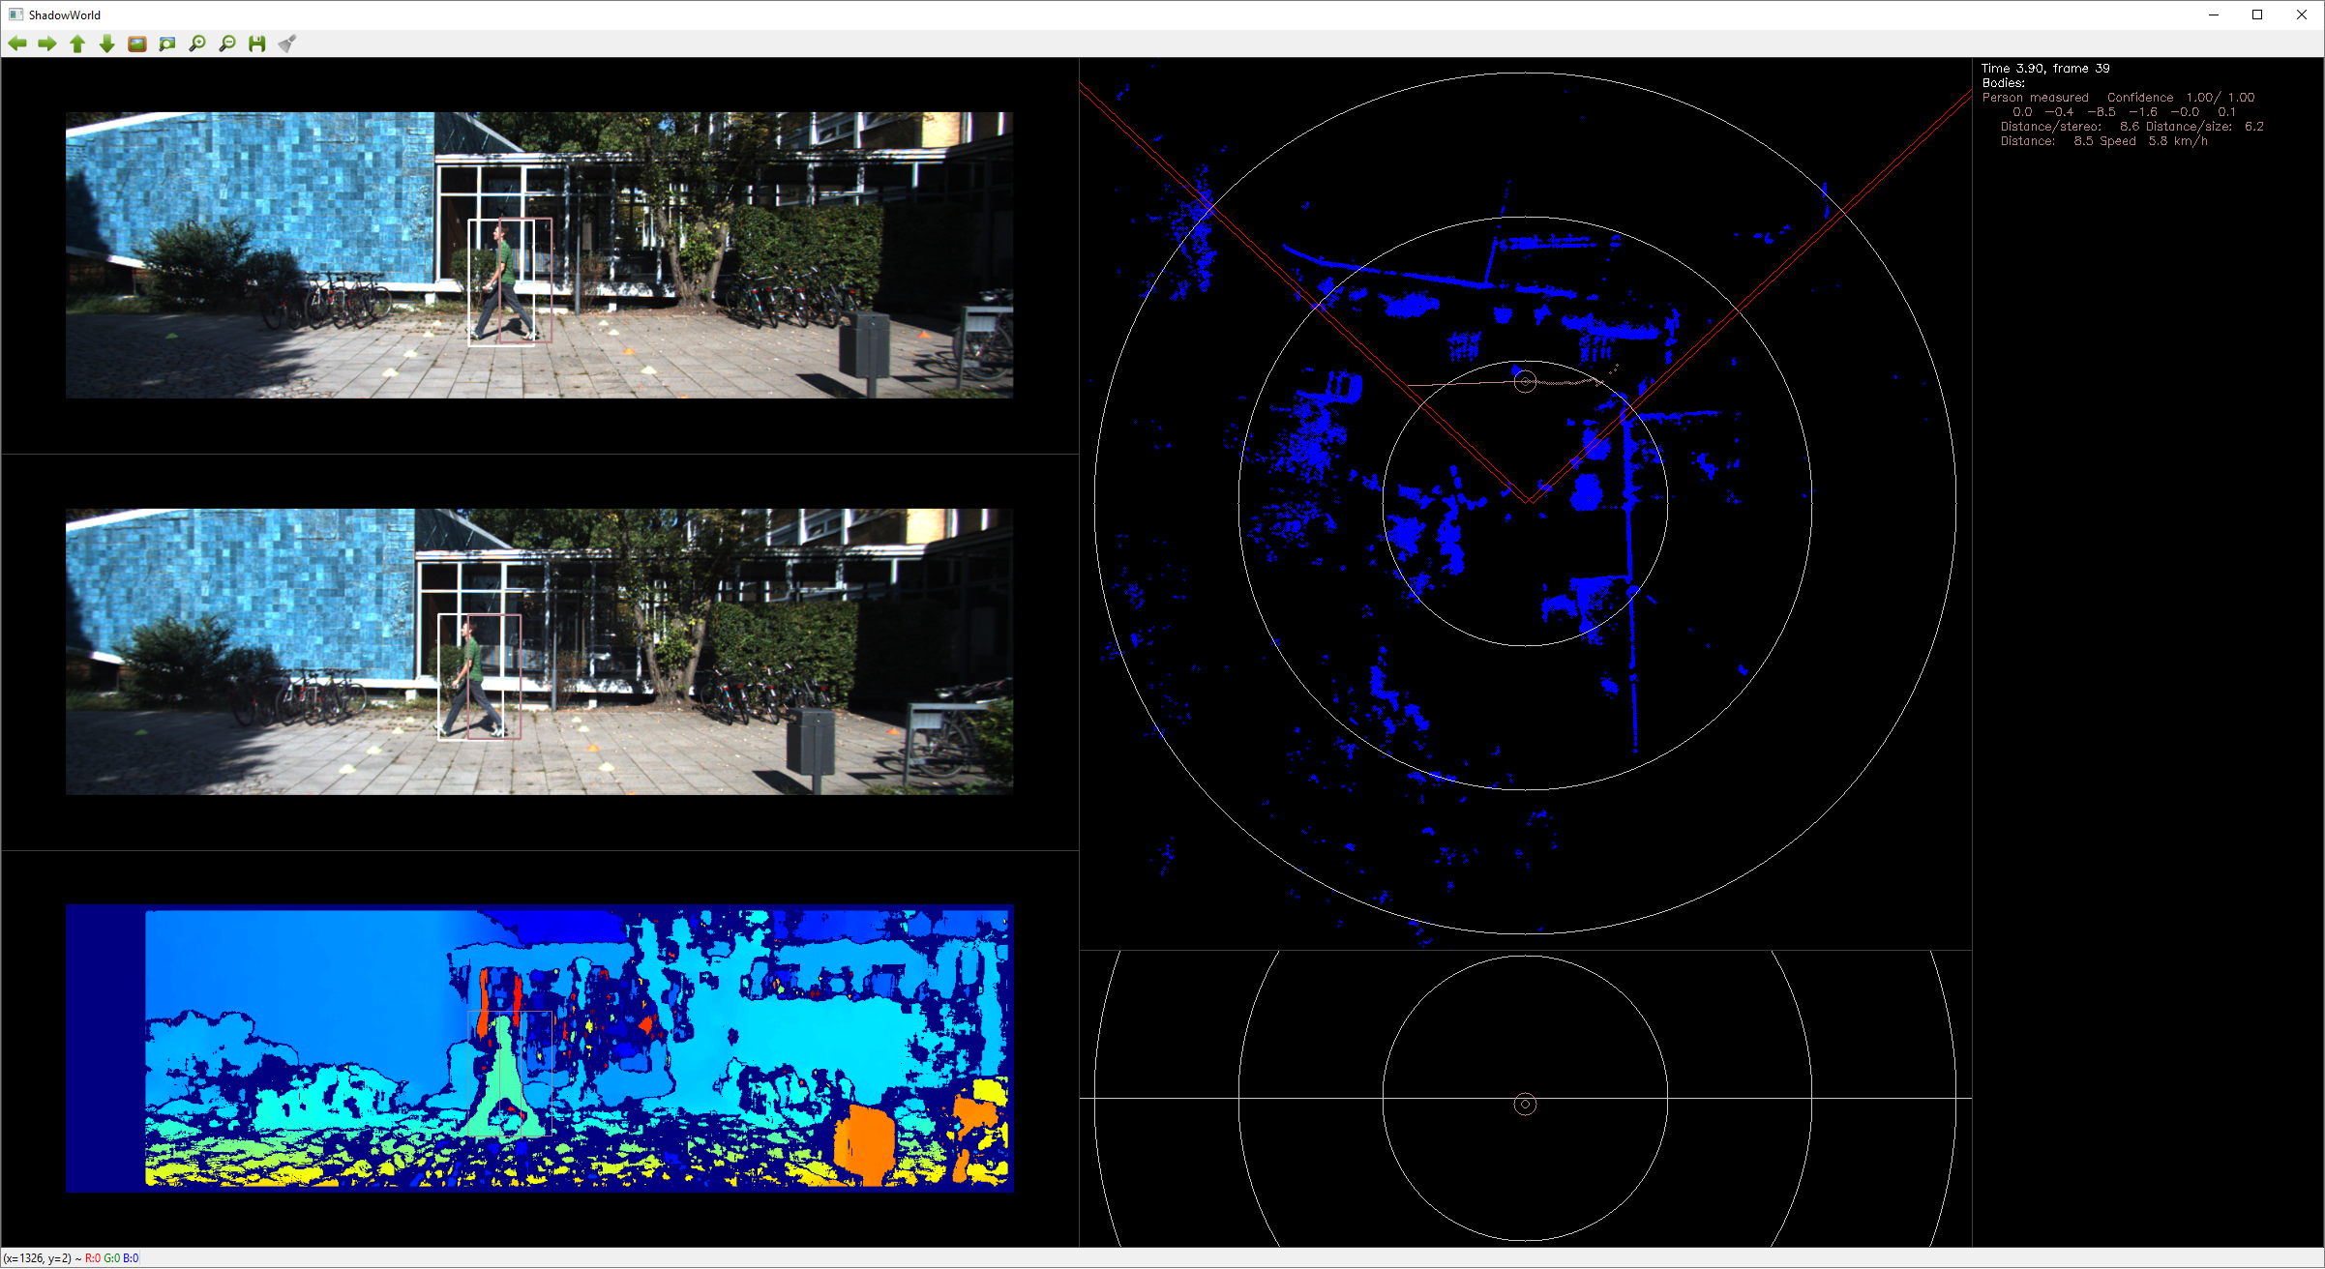

Slide 32
Matching algorithm
For left camera:
Create detections
Predict pattern locations
Match detections to patterns
For each unmatched detection
Create pattern
Create body
For right camera:
Create detections
Match right camera detections to left camera patterns
Predict body locations
Create location measurements based on size and stereo
Correct body locations

Slide 33
Kalman Filter Parameter Adjustments
Two levels of filtering:
Pattern
Pattern movement estimation for missing detections
Body
Coordinate and velocity estimation

Slide 34
Detection
Pattern
Body
x_min
K1
x_min’
Distance estimation + 3D projection
x_max
K1
x_max’
K2
Left
y_min
K1
y_min’
x’
y’
y_max
K1
y_max’
x
z’
y
x_min
z
vx’
vy’
x_max
Right
vz’
y_min
y_max
Camera parameters

Slide 35
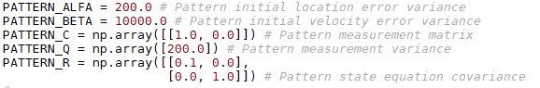
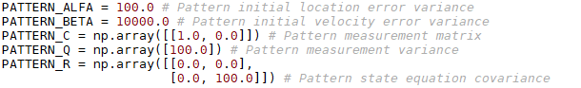
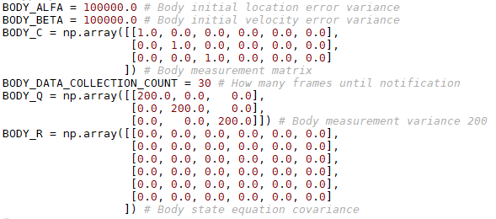

Before
After

Slide 36
PATTERN_ALFA
2*std = 20px, first detection bounding box accuracy
PATTERN_BETA
2*std = 200 px/s = 20 px / frame
PATTERN_Q
2*std = 20px, detection accuracy
PATTERN_R
Location, no teleporting
Velocity, 2*std = 20px/frame = 200 px/s
BODY_ALFA
2*std = 6 m, first location accuracy
BODY_BETA
2*std = 20 m/s
BODY_Q
2*std = 10m, measurement accuracy
BODY_R
Location, no teleporting
Velocity (x,z), 2*std = 2 m/s2
Velocity (y), 2*std = 0,6 m/s2

Slide 37


Pattern location / before
Pattern location / after

Slide 38


Pattern velocity / before
Pattern location / after

Slide 39


Body location / before
Body location / after

Slide 40


Body location / before
Body location / after

Slide 41

Body Volume and Orientation
Bounding sphere is not a good shape for volumes like car, human or train…
KITTI uses bounded 3D box

Slide 42


Assumption: Only yaw allowed
Each body is supposed to have “normal” movement direction, which defines length, height and width.
p₅
p₁
y
p₆
p₂
velocity = (v_{x},v_{y},v_{z})
α = yaw angle
p
height
p₇
p₃
α
x
p₈
p₄
width
length
$$α=atan2({−v}_{z},v_{x})$$
z
$$(p_{1,x},p_{1,y},p_{1,z})=(p_{x}+0.5∗length, { p}_{y}+0.5∗heigth,{ p}_{z}−0.5∗width)$$
…
$$(p_{8,x},p_{8,y},p_{8,z})=(p_{x}−0.5∗length, { p}_{y}−0.5∗heigth,{ p}_{z}+0.5∗width)$$

Slide 43






p’₁
Top view
b
v
p₅
n
p₁
$$α=atan2({−v}_{z},v_{x})$$
a
α
p₂
$\left[\begin{matrix}{p′}_{x,i} \\ {p′}_{y,i} \\ {p′}_{z,i}\end{matrix}\right]$= $\left[\begin{matrix}cos⁡(α) & 0 & sin⁡(α) \\ 0 & 1 & 0 \\ −sin⁡(α) & 0 & cos⁡(α)\end{matrix}\right]$* $\left[\begin{matrix}p_{x,i} \\ p_{y,i} \\ p_{z,i}\end{matrix}\right]$
p’₅
x
p
p₆
p’₂
p’₆
z
y
y’₁
$$y_{1}^{′}=height/2$$
Side view
$$y_{2}^{′}=−height/2$$
x’₂
x’₁
x
$$x_{1}^{′}=max⁡(x_{1},x_{2},x_{3},x_{4},x_{5},x_{6},x_{7},x_{8})$$
$$x_{2}^{′}=min⁡(x_{1},x_{2},x_{3},x_{4},x_{5},x_{6},x_{7},x_{8})$$
y’₂

Slide 44
The Big Picture

Slide 45







Matching
Pattern filtering
Distance estimation
3D projection
Body filtering
Body prediction
Collision detection
…
CNN + Object Detection
Semantic Segmentation
Visual Analysis
Bodies (+attributes)
Context
Forecasts
Collision probabilities
Other representations
Voice
High female
Low female
High male
Low male
Stereo Vision
Commands Questions
Speech Generation
Speech Synthesis
Words per minute: max 150…160
Priority queue, active dropping
Speech Recognition
Speech Analysis
Q/A: (Answer voice: NOTICE)
Syntactic classification
Semantic classification
Generated based on situation:
Commands:

Slide 46
Class Diagram
PresentationForecast
PresentationMap
PresentationLog
…
Presentation
ObjectDetector
Speech
Synthesizer
World
Camera
”World object”
”Image object”
”Detected object”
Event
Body
Pattern
Detection
Trace
Forecast
Bounding
Box

Slide 47
Next Steps

Slide 48
Kalman filter parameter adjustments (Q1)
Dataset selection (Q1)
Stereo vision (Q2)
Camera yaw, pitch, roll estimation (Q2)
Speech recognition (Q2)
Semantic segmentation (Q2)
Experiments in the wild (Q2)
Paper (Q3)
Speech analysis (Q3)
Speech generation (Q3)
Use cases (Q4)
Next steps

Slide 49
Discussion

Slide 50
Thank you!
lampola@student.tut.fi
https://github.com/SakariLampola/Thesis

